Slide 1
BRUU Congregational Survey: A Minister Profile
Dianne Lane
Charlie Grymes
February 13, 2025

Slide 2
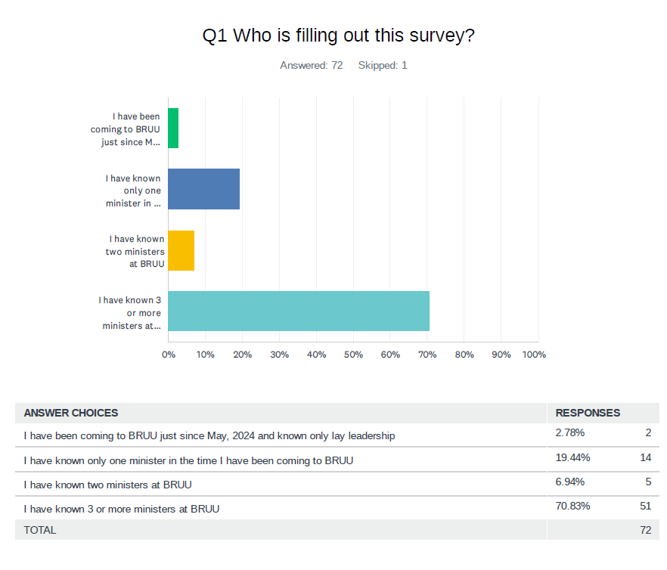
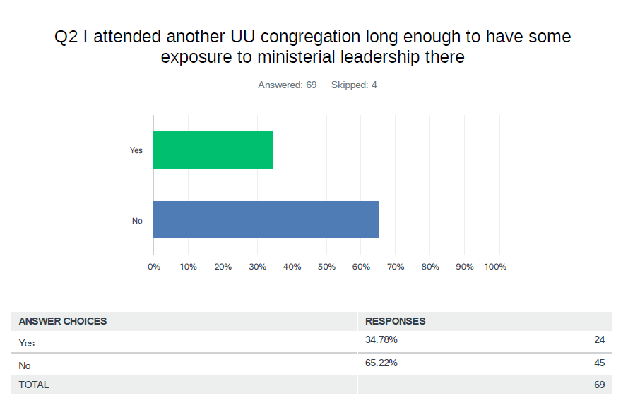
Demographic data
Survey conducted via SurveyMonkey and hard copy; advertised in RoundUp, OoS, Charlie at Coffee Hour
Questions were not mandatory; respondents could choose to skip a question

Slide 3
Themes – Gap analysis – common themes (60 comments)
Greater spiritual nourishment in services
Officiant for life’s milestones (weddings, funerals, illness)
A consistent public facing representative to the community
Trained personnel for pastoral care
Relief for the Worship Committee
More coherence across the services, aligned to our vision
A religious navigator for spiritual nourishment, social justice work, and increased ties to UU as a religion
There was great appreciation expressed for the Worship Committee and also fear for member burn out

Slide 4
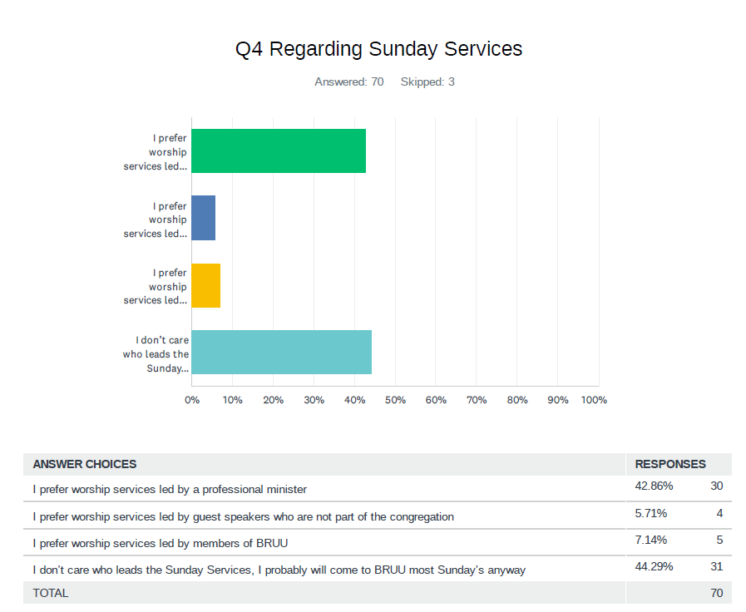
Sermon feedback
Themes
There were 46 comments
All 4 options had champions; most preferred a
part-time minister supplemented by outside speakers
and lay leaders
There were some respondents who said that
a professionally trained minister would provide
continuity between services, single focus of UU
spirituality
Empathy, compassion, and thought-provoking
speaker skills were aspects of sermons
deemed important
There was great appreciation for the lay leaders and Worship Committee for the sermons delivered since May

Slide 5
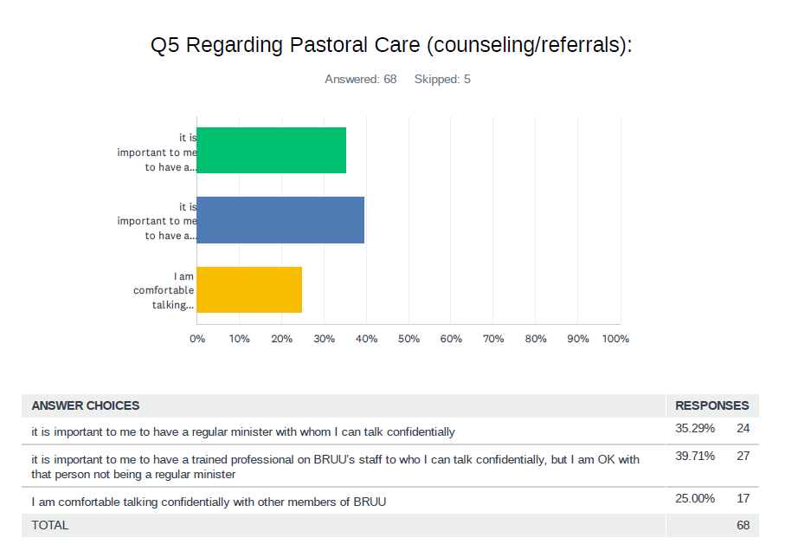
Pastoral care – counseling/referrals
Themes
There were 22 comments
Respondents were fairly evenly split; there was emphasis that a minister or trained professional on BRUU’s staff have skills in active and empathetic listening
Another series of comments focused on wanting to be able to discuss theology, ethics, moral questions
There were several comments though that this was not an aspect of ministry that was required by the respondent

Slide 6
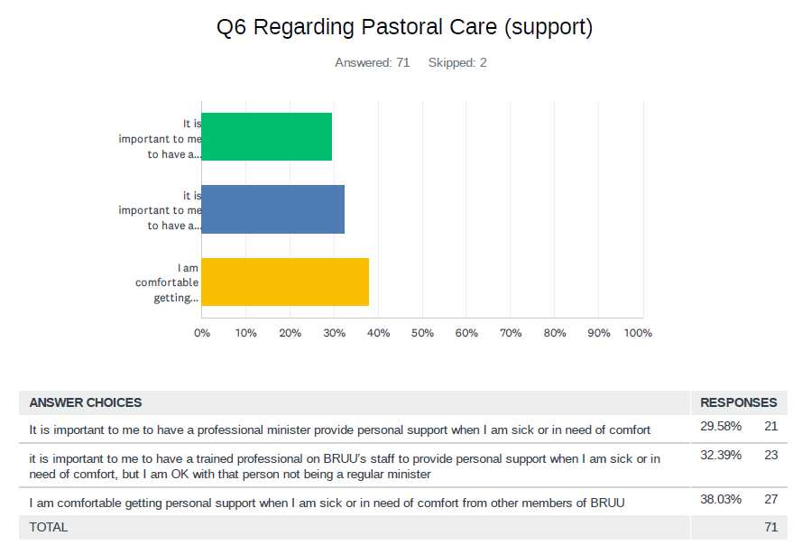
Pastoral care - support
Themes
There were 24 comments
Respondents were fairly evenly split; there was emphasis that a minister or trained professional on BRUU’s staff have skills in active and empathetic listening
There were comments appreciative of pastoral care team for illness/cards but a gap in life events (deaths, serious illness)
There was a theme that any minister needs to have a strong pastoral care foundation and BRUU should look for that

Slide 7
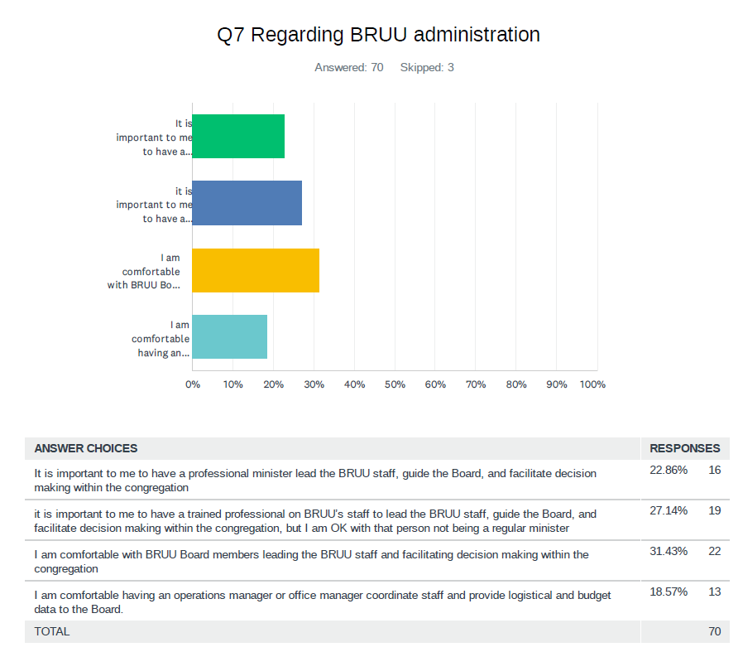
Minister’s role in BRUU administration
Themes
There were 35 comments
There were comments that emphatically stated that the minister should focus on sermons, pastoral care and not be over the Board
There was support for an operations/office manager or someone on the Board who understands business management
The idea of the Board leading staff had supporters but concern about burn out, too big a responsibility were comments of caution (recruitment of new Board members could be become harder)

Slide 8
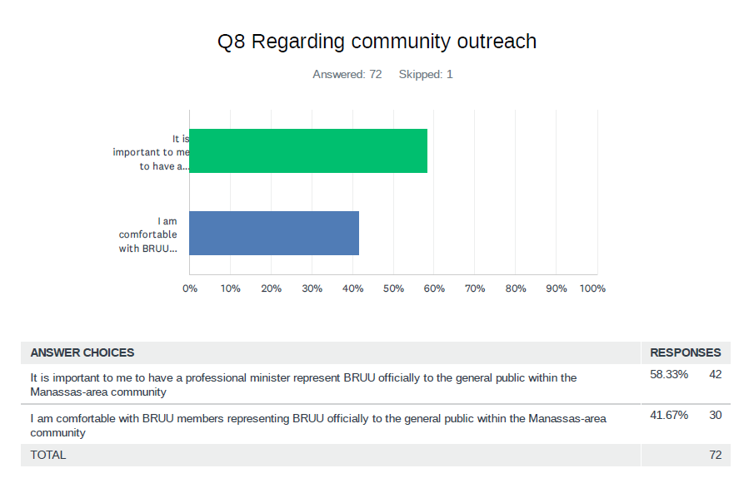
Minister’s role in community outreach
Themes
There were 22 comments
The dominant comments stated that a minister is best-suited to networking, social justice interactions (other clergy), and being the public face of BRUU
There was support for the committee leads, BRUU members being the face of BRUU through deeds and engagement
Note: Minister was the role; status as part-time was seen as acceptable

Slide 9
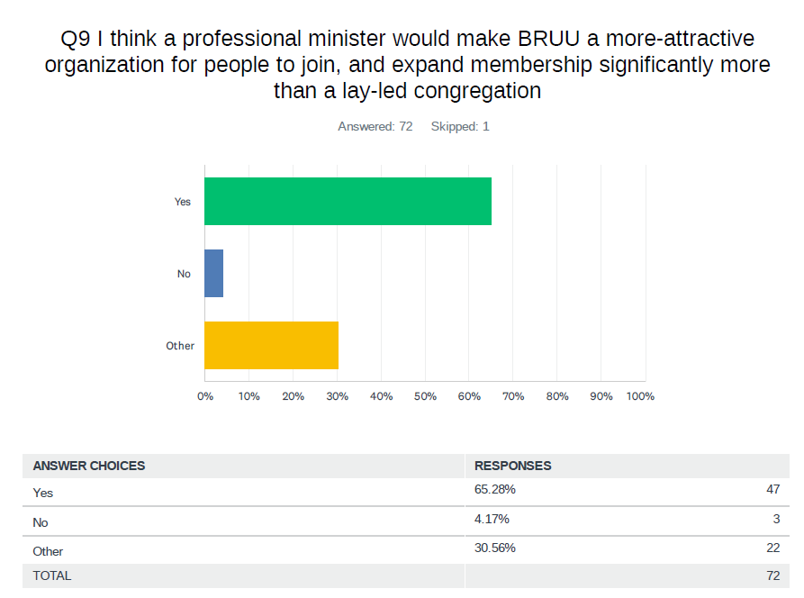
Minister’s role in attracting new members
Themes
There were 22 comments
The majority of the comments focused on being uncertain whether a professional minister would attract new members

Slide 10
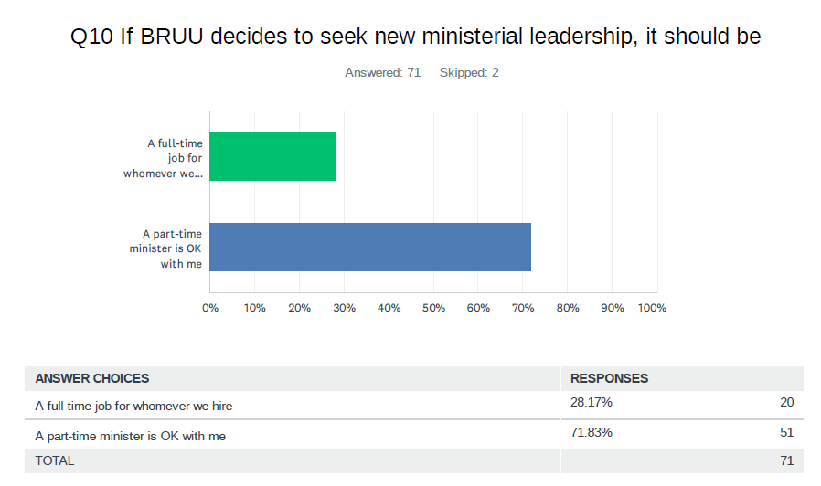
Minister – full or part-time
Themes
There were 30 comments
Comments were a mix of balancing responsibilities with a work week and BRUU’s budget (part time vs full time)
There were comments about ensuring alignment of expectations between any minister and the congregation
There were recommendations for contract ministers with a path to hire, part-time ministers with associated scaled responsibilities, full-time new (young) minister to grow with BRUU
There were comments on ministerial accountablity, compensation, and prioritizing what BRUU wants (expectations)
There was resignation that a part-time minister is most practical but a desire for a full-time

Slide 11
What else should we know? (42 comments)
Need to keep young people engaged, providing leadership opportunities and connection to BRUU through the transition from youth to adult
Engage with young leaders to identify innovative strategies to grow membership
Hire a part-time contract minister with empathy, recognize professional staff, prevent volunteer burnout
Professional office management support (see earlier comments)
Addition of a bookkeeper would simplify operations
Grateful and appreciative of David, Kristen, Taylor and George – recognize them!
Continue open and transparent communications
BRUU has brought in multiple consultants – follow their advice
Make the music director full time
Hire someone – we need a minister

